Slide 1
Docker

Slide 2

Agenda
Docker history
What is docker
Architecture
Images
Containers
Terminology
Docker hub
Advanced topic

Slide 3
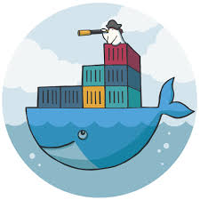
Docker History
A dotCloud (PAAS provider) project
Initial commit January 18, 2013
Docker 0.1.0 released March 25, 2013
18,600+ github stars, 3800+ forks,740 Contributors…. and continues

Slide 4
What is Docker ?!!!
Open platform for developers and sysadmins to build, ship and run distributed applications
Can run on popular 64-bit Linux distributions with kernel 3.8 or later
Supported by several cloud platforms including Amazon EC2, Google Compute Engine, and Rackspace.

Slide 5
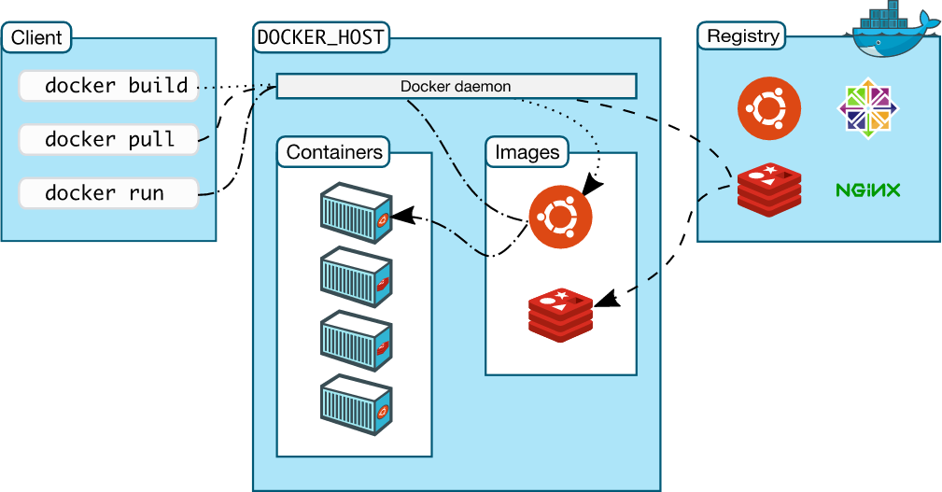
Docker Architecture……

Slide 6
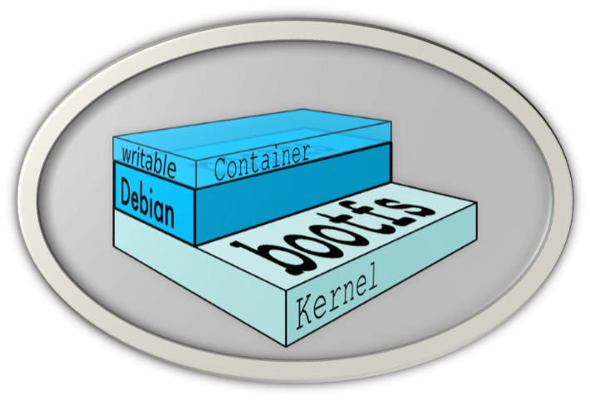
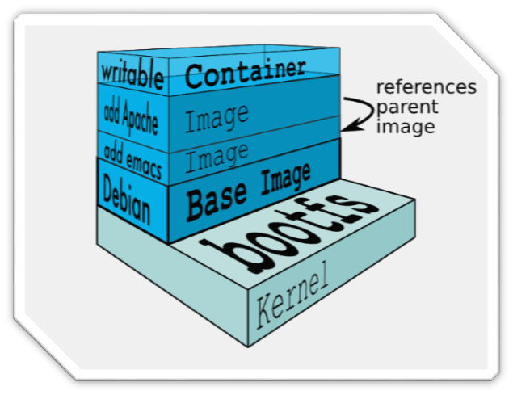
Docker images……
NOT A VHD
NOT A FILESYSTEM
uses a Union File System
a read-only Layer
do not have state
Basically a tar file
Has a hierarchy
Arbitrary depth
Fits into the Docker Registry

Slide 7
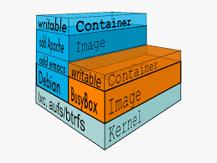
Docker Containers...
Units of software delivery (ship it!)
Run everywhere
Regardless of kernel version
Regardless of host distro (but container and host architecture must match*)
Run anything
If it can run on the host, it can run in the container
i.e., if it can run on a Linux kernel, it can run

Slide 8
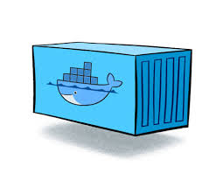
How does Docker work ?
You can build Docker images that hold your applications
You can create Docker containers from those Docker images to run your applications.
You can share those Docker images via Docker Hub or your own registry

Slide 9
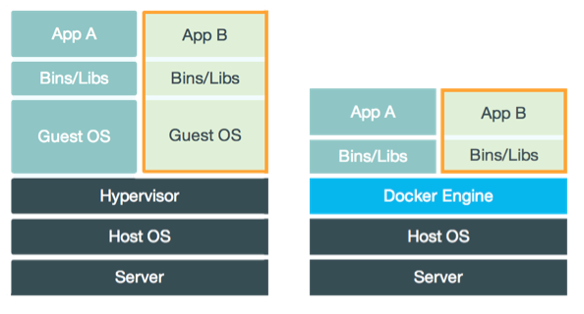
Virtual Machine Versus Container……

Slide 10
Docker Container Lifecycle..
• The Life of a Container
– Conception
• BUILD an Image from a Dockerfile
– Birth
• RUN (create+start) a container
– Reproduction
• COMMIT (persist) a container to a new image
• RUN a new container from an image
– Sleep
• KILL a running container
– Wake
• START a stopped container
– Death
• RM (delete) a stopped container
• Extinction
– RMI a container image (delete image)

Slide 11
Hello World
Simple Command - Ad-Hoc Container
docker run ubuntu echo Hello World
docker images [-a]
docker ps –a
Run Docker in daemon mode
docker run -d <image name>
Run Docker in interactive mode
docker run -it ubuntu

Slide 12

Terminology - Image
Persisted snapshot that can be run
images: List all local images
run: Create a container from an image and execute a command in it
tag: Tag an image
pull: Download image from repository
rmi: Delete a local image
This will also remove intermediate images if no longer used

Slide 13
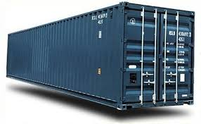
Terminology - Container
Runnable instance of an image
ps: List all running containers
ps –a: List all containers (incl. stopped)
top: Display processes of a container
start: Start a stopped container
stop: Stop a running container
pause: Pause all processes within a container
rm: Delete a container
commit: Create an image from a container

Slide 14
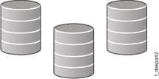
Mount Volumes
docker run –ti –v /hostLog:/log ubuntu
Run second container: Volume can be shared
docker run –ti --volumes-from firstContainerName ubuntu

Slide 15

Publish Port/Linking
docker run –t –p 8080:80 ubuntu nc –l 80
Map container port 80 to host port 8080
Link with other docker container
docker run -ti --link containerName:alias ubuntu

Slide 16
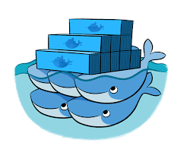
Docker Hub
Public repository of Docker images
https://hub.docker.com/
docker search [term]
Automated: Has been automatically built from Dockerfile
Source for build is available on GitHub

Slide 17

Docker Use Cases
Development Environment
Environments for Integration Tests
Quick evaluation of software
Microservices
Multi-Tenancy
Unified execution environment (dev → test → prod (local, VM, cloud, ...)

Slide 18
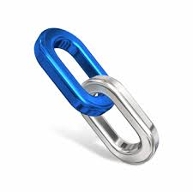
Documentation
Docker homepage: https://www.docker.com/
Introduction: https://www.docker.com/whatisdocker/
Online tutorial: https://www.docker.com/tryit/
Installation and user guide: https://docs.docker.com/

Slide 19

Docker: Advanced Topics
Dockerfile:
https://www.digitalocean.com/community/tutorials/docker-explained-using-dockerfiles-to-automate-building-of-images
Docker Compose:
https://docs.docker.com/compose/overview/
Docker Swarm:
https://docs.docker.com/swarm/overview/
Docker Machine:
https://docs.docker.com/machine/overview/
Consul:
https://www.consul.io/
Nomad:
https://www.nomadproject.io/

Slide 20

SUMMARY……
Easy to build, run & share containers
Rapidly expanding ecosystem
Better performance vs. VMs
Layered file system gives us git-like control of images
Reduces complexity of system builds
Red Hat - Project Atomic Host, and certifications - containerized applications, Geard and OpenShift.
Google is expected to tightly integrate containers with its IaaS and PaaS offerings.

Slide 21

Questions ?

